Slide 1
Chapter 3
Differentiation
Copyright © 2010 Pearson Education, Inc. Publishing as Pearson Addison-Wesley

Slide 2
3.1
Tangents and the
Derivative at a Point
Copyright © 2010 Pearson Education, Inc. Publishing as Pearson Addison-Wesley

Slide 3
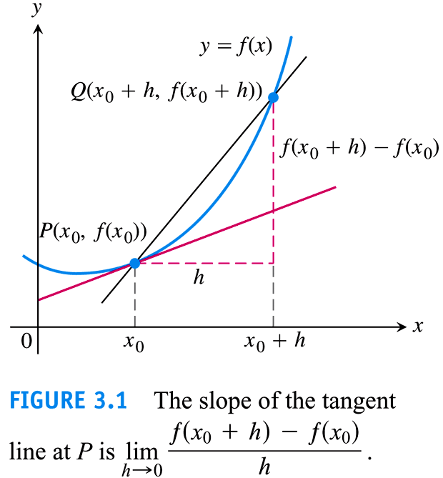

Slide 4


Slide 5
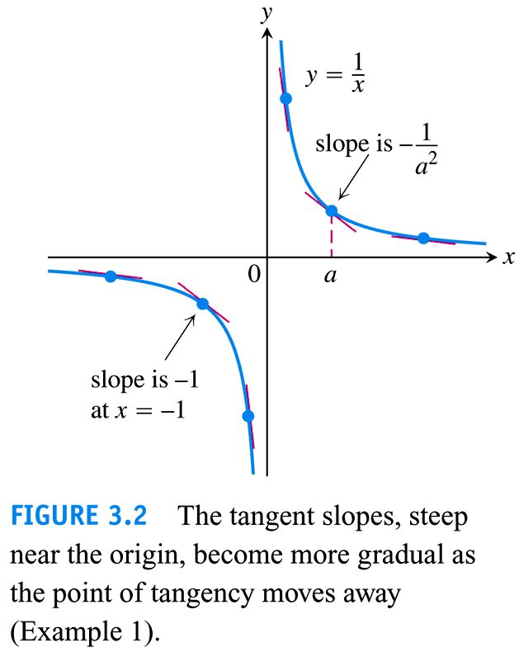

Slide 6
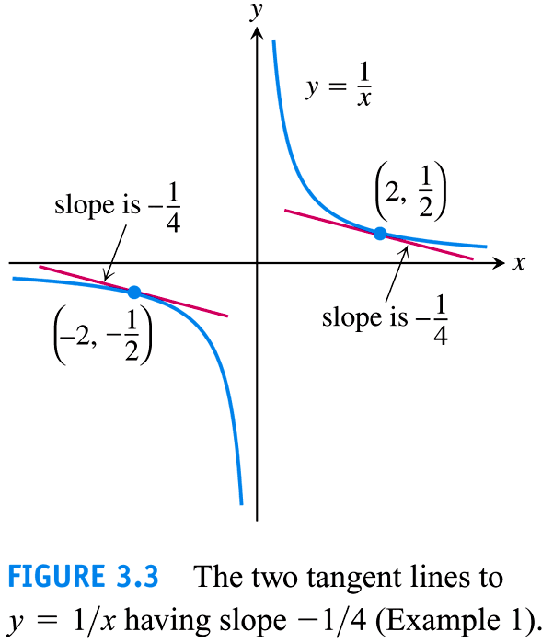

Slide 7


Slide 8
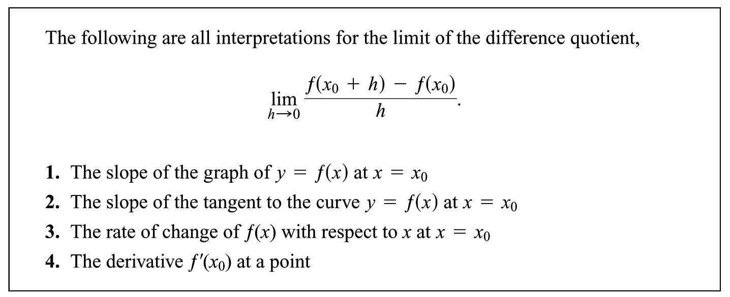

Slide 9
3.2
The Derivative as a Function
Copyright © 2010 Pearson Education, Inc. Publishing as Pearson Addison-Wesley

Slide 10


Slide 11
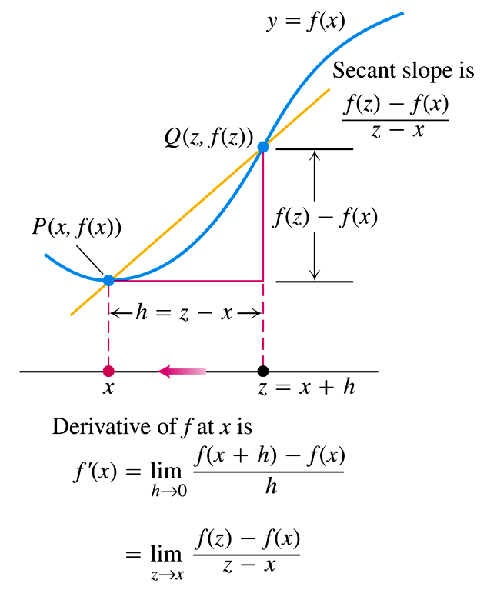


Slide 12


Slide 13
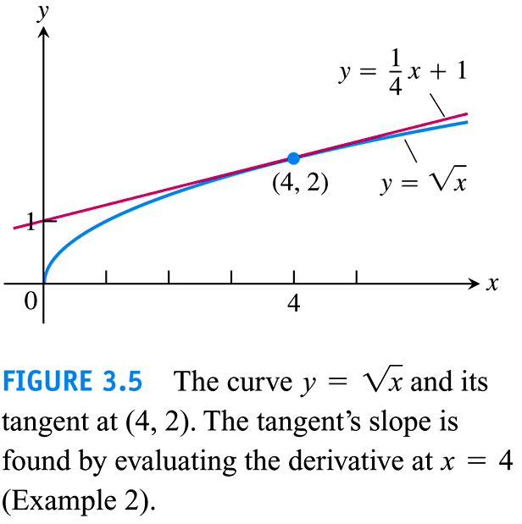

Slide 14
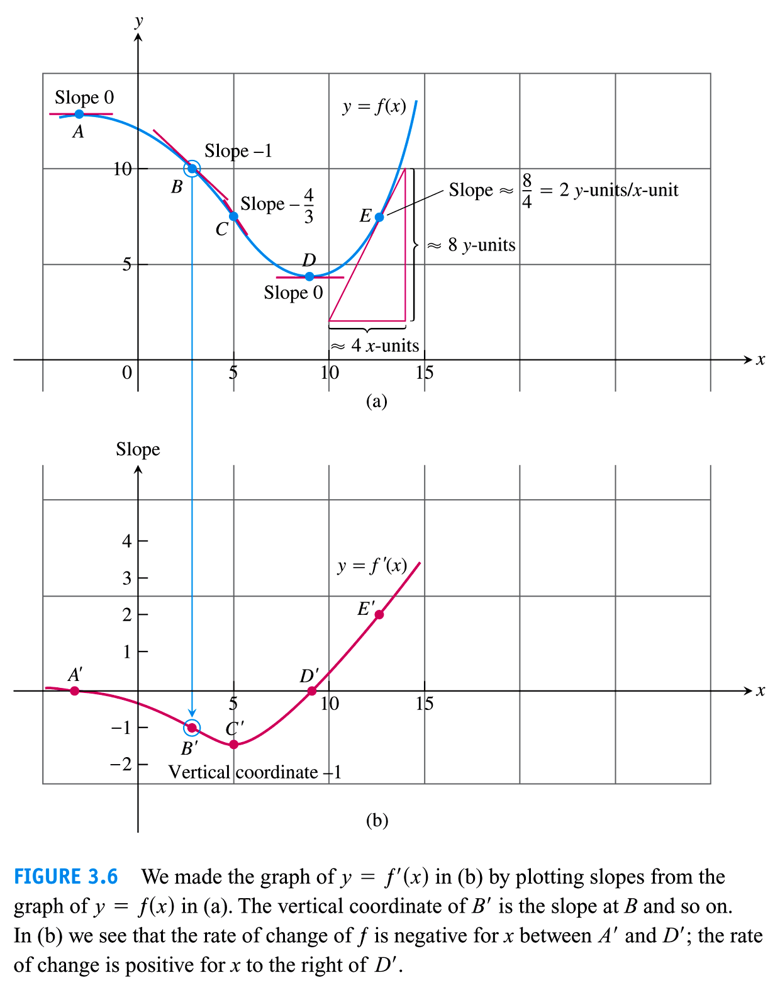

Slide 15
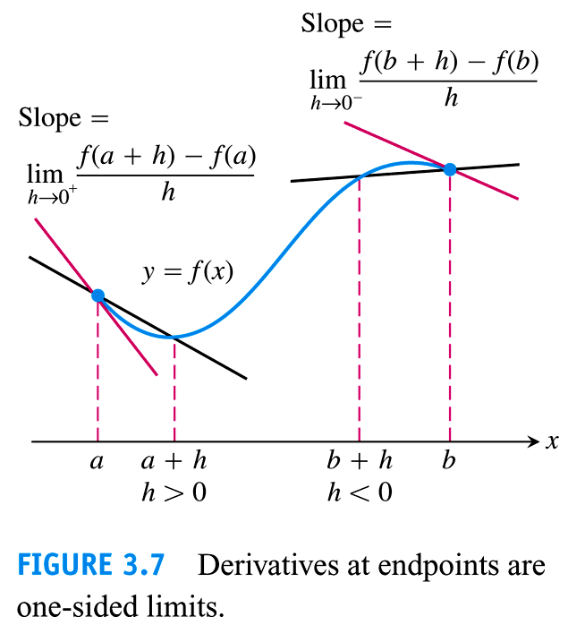

Slide 16
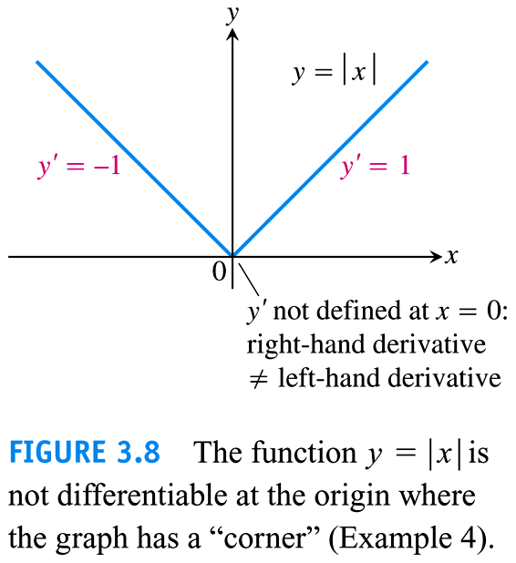

Slide 17
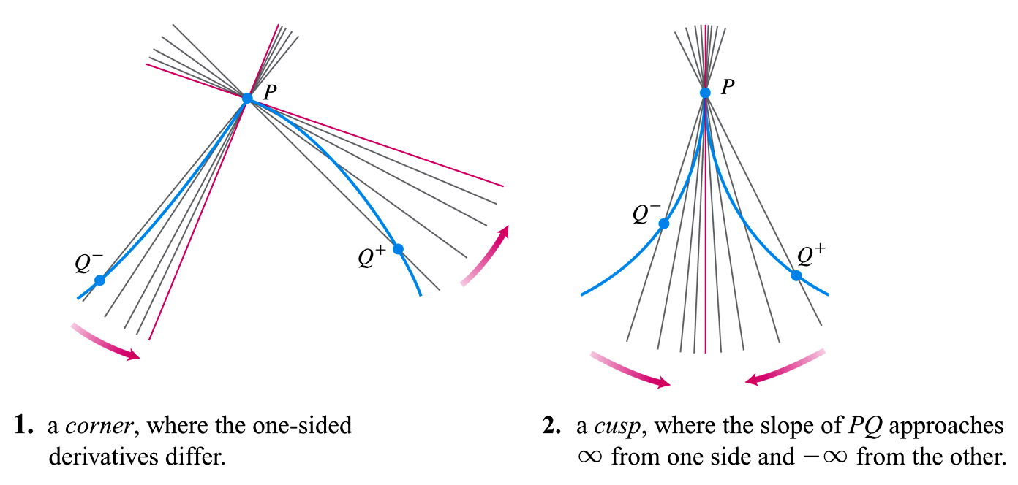

Slide 18
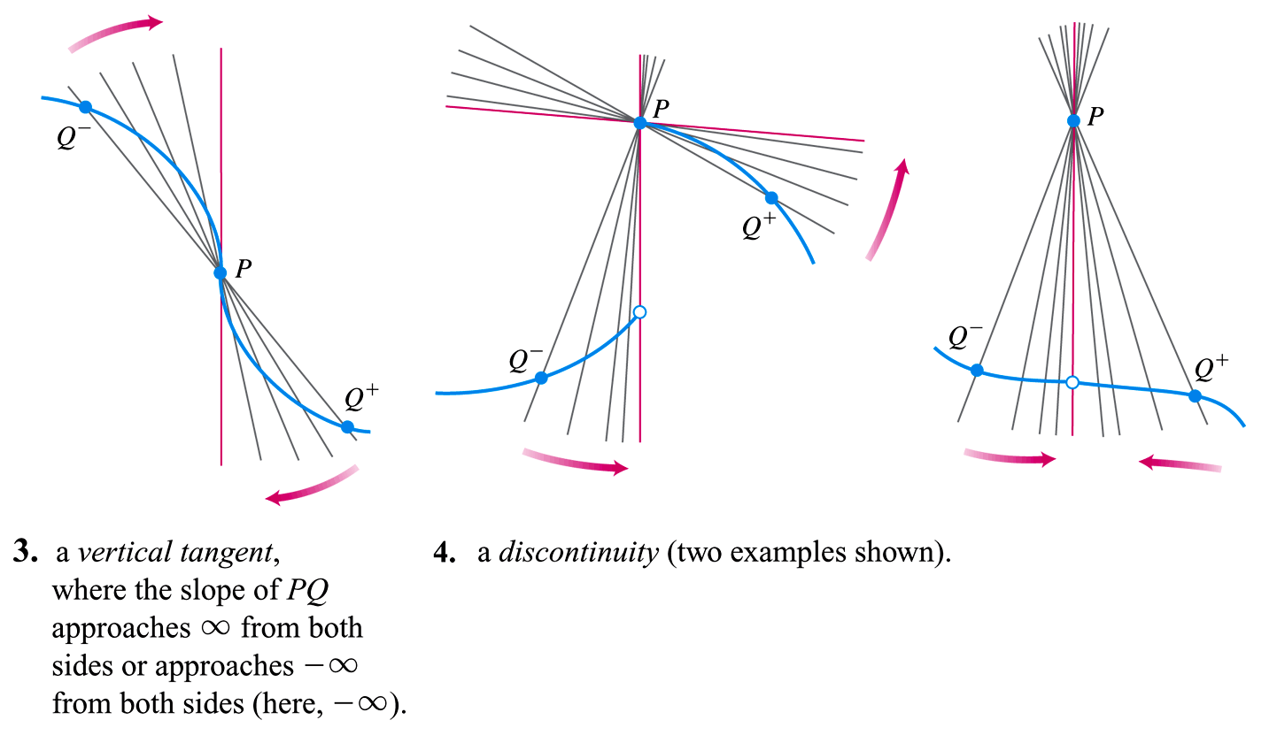

Slide 19


Slide 20
3.3
Differentiation Rules
Copyright © 2010 Pearson Education, Inc. Publishing as Pearson Addison-Wesley

Slide 21
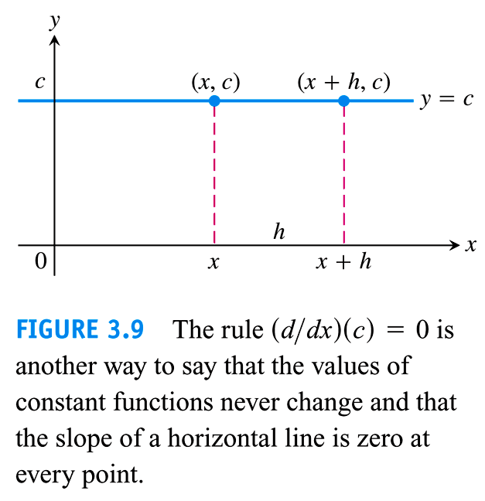

Slide 22


Slide 23


Slide 24


Slide 25


Slide 26
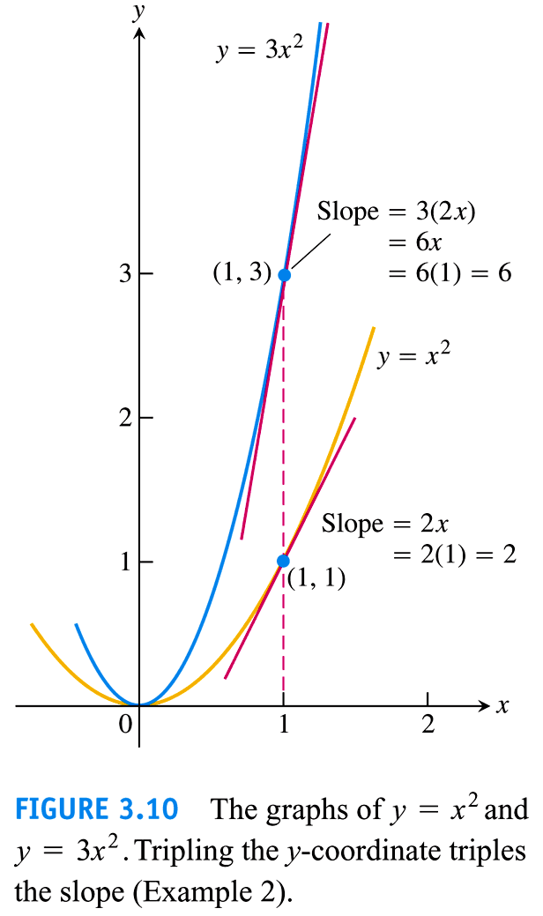

Slide 27


Slide 28
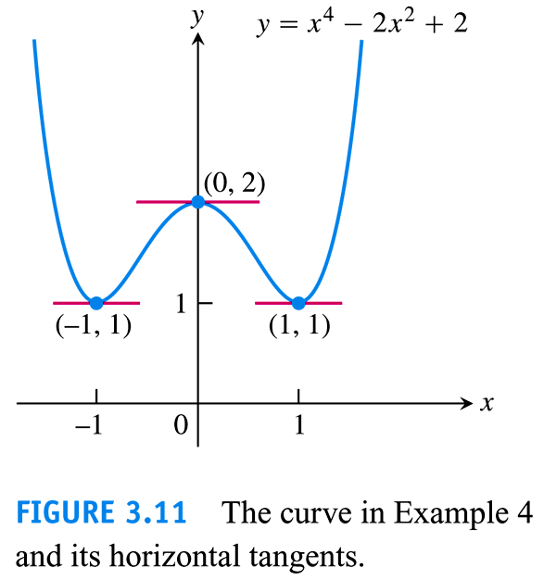

Slide 29


Slide 30


Slide 31
3.4
The Derivative as a Rate of Change
Copyright © 2010 Pearson Education, Inc. Publishing as Pearson Addison-Wesley

Slide 32


Slide 33
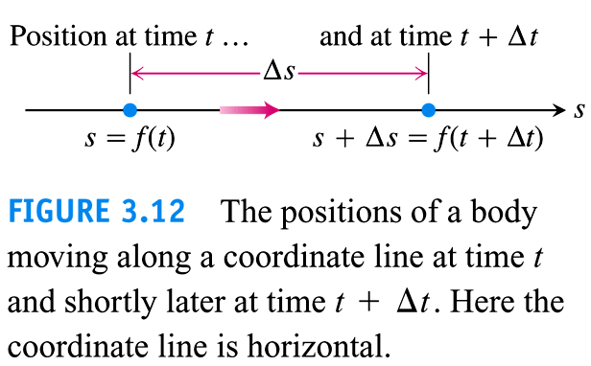

Slide 34


Slide 35
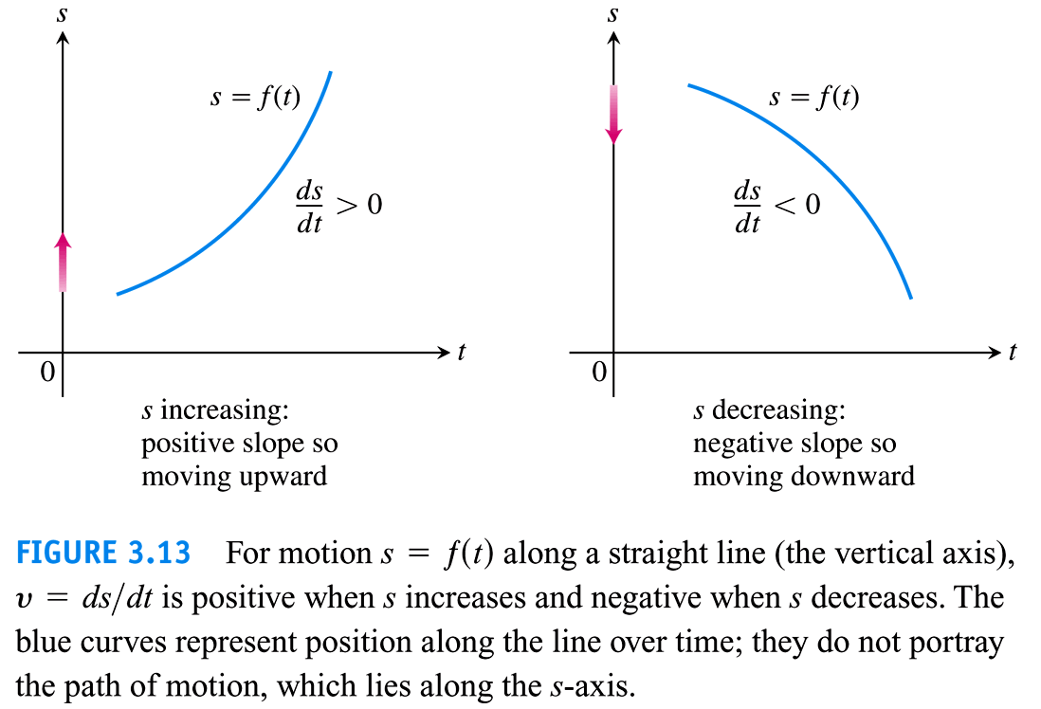

Slide 36


Slide 37
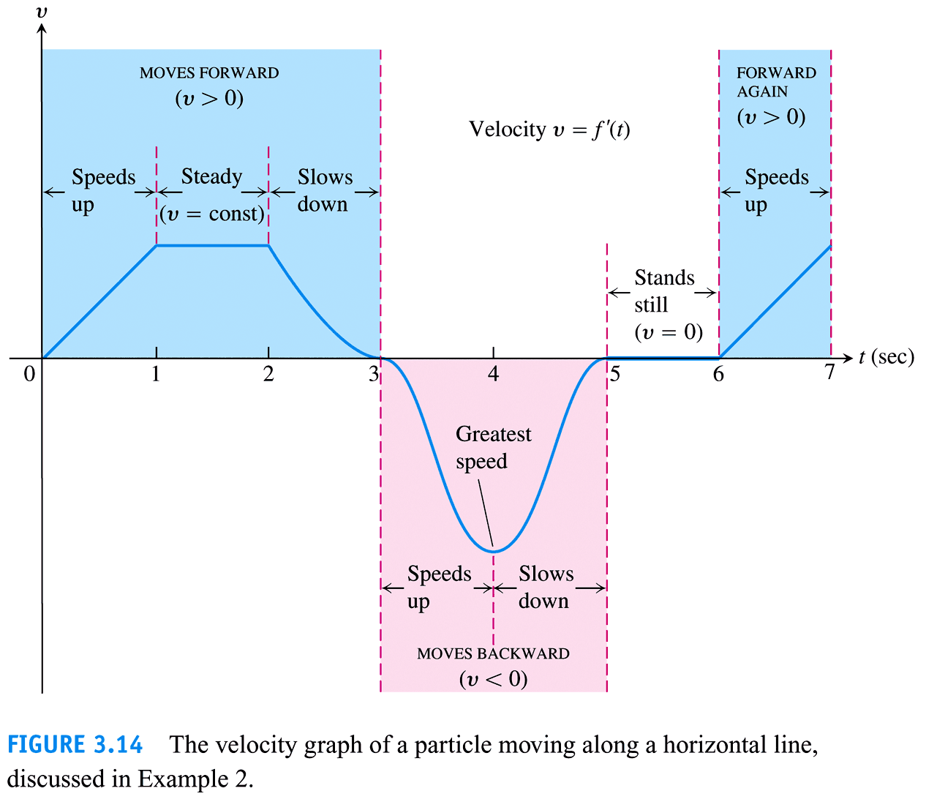

Slide 38
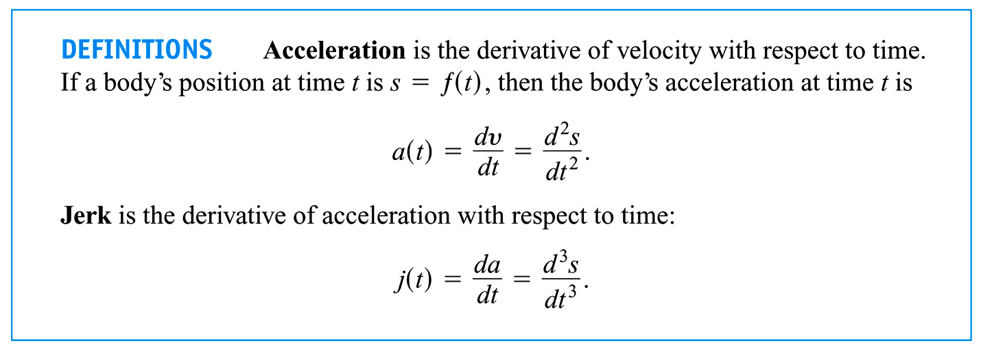

Slide 39
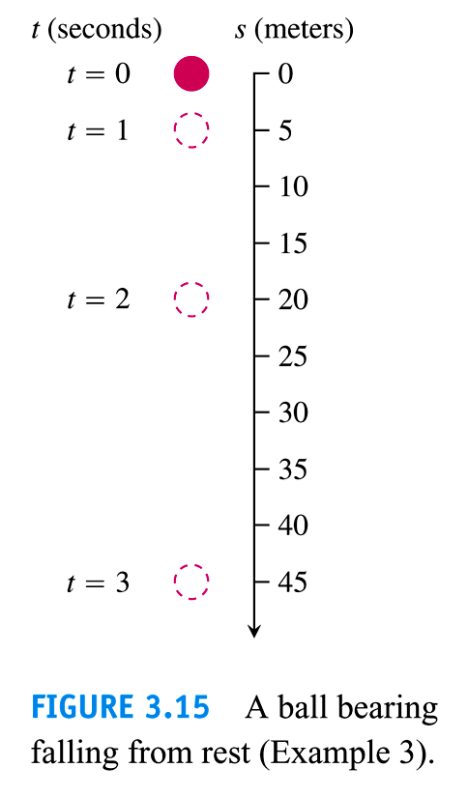

Slide 40
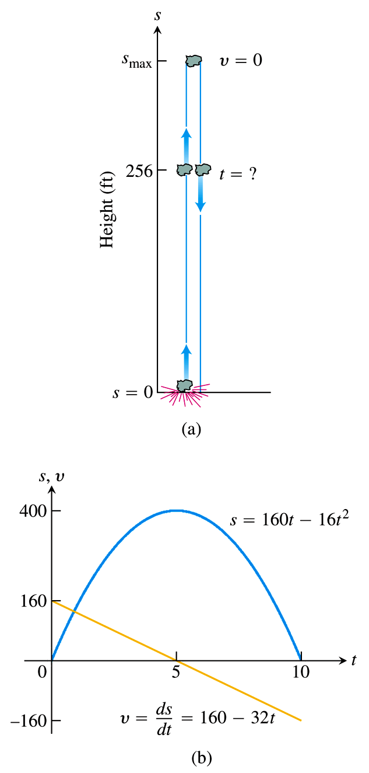
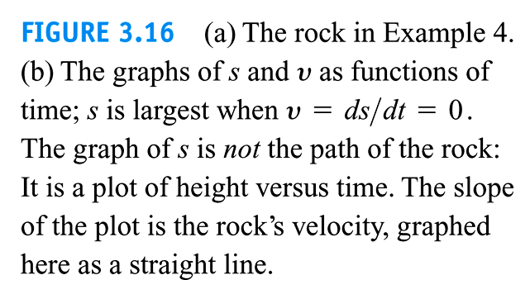

Slide 41
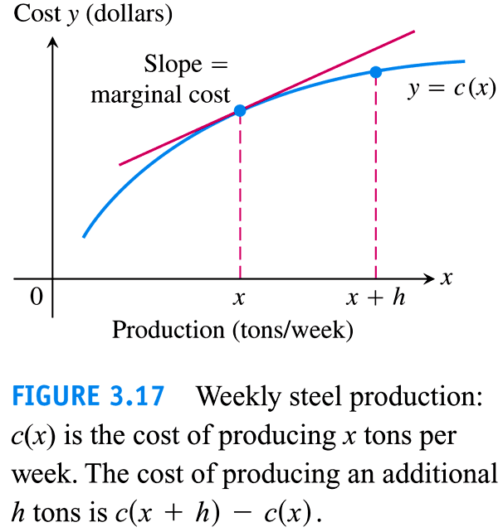

Slide 42
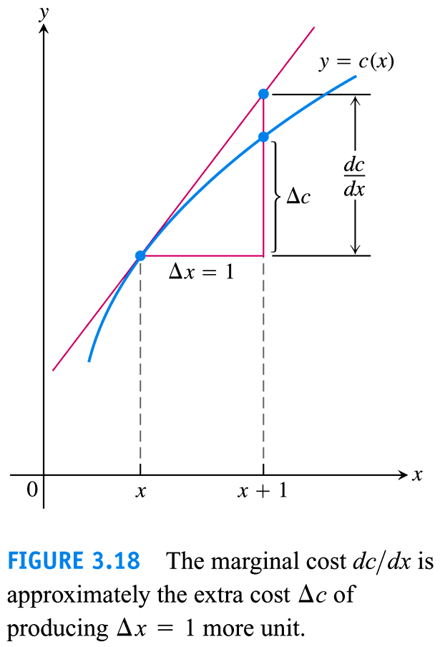

Slide 43
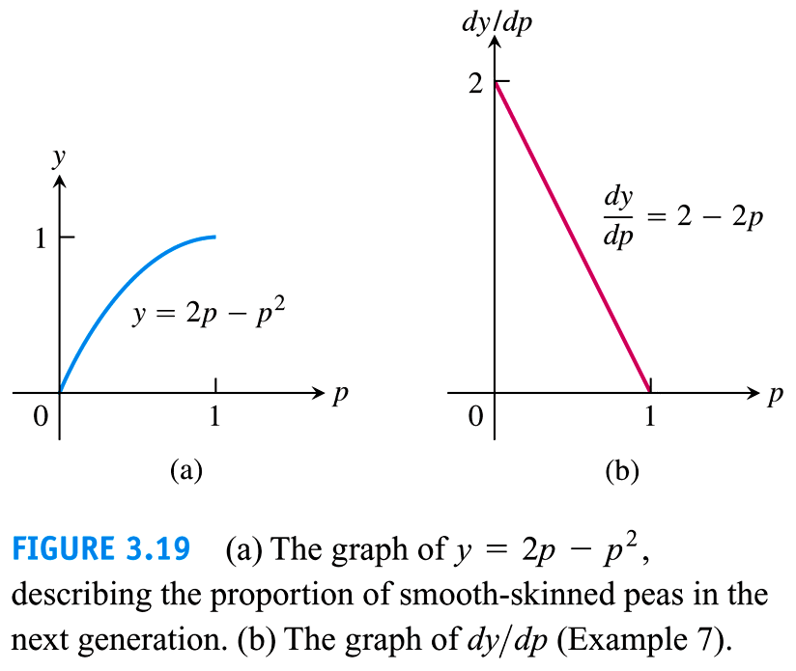

Slide 44
3.5
Derivatives of Trigonometric Functions
Copyright © 2010 Pearson Education, Inc. Publishing as Pearson Addison-Wesley

Slide 45


Slide 46
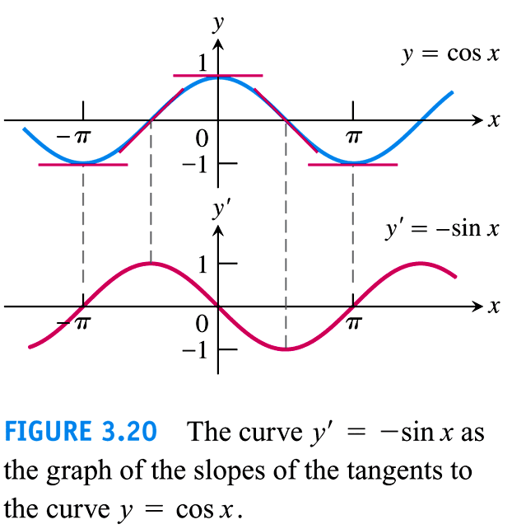

Slide 47


Slide 48
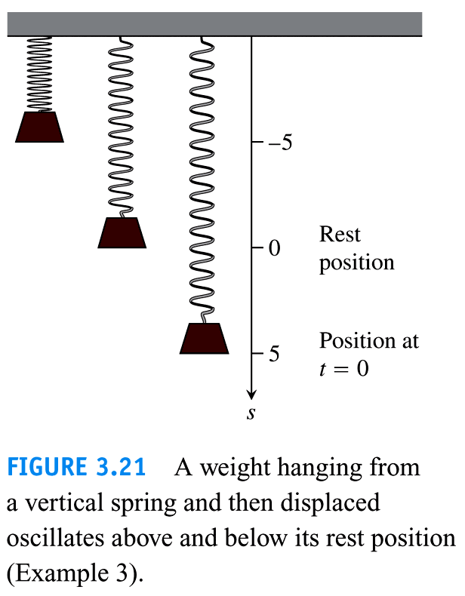

Slide 49
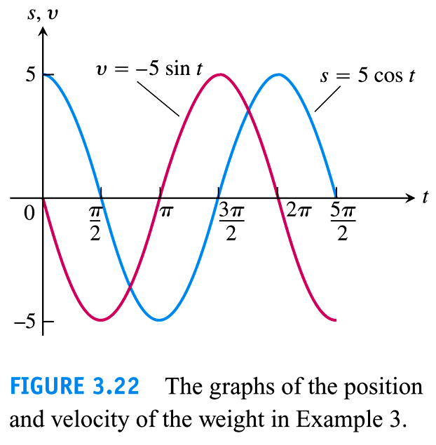

Slide 50


Slide 51
3.6
The Chain Rule
Copyright © 2010 Pearson Education, Inc. Publishing as Pearson Addison-Wesley

Slide 52
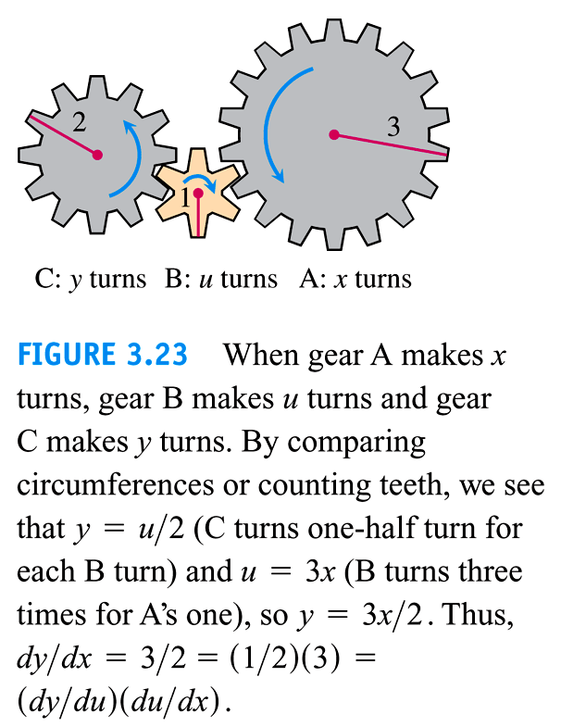

Slide 53
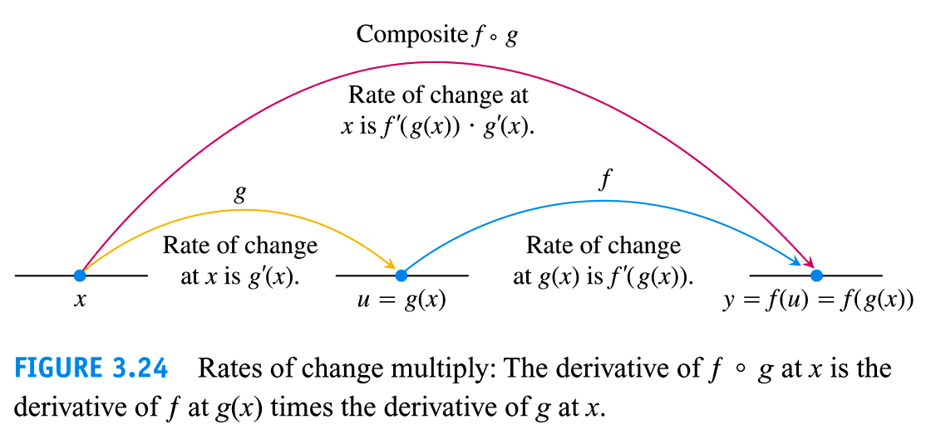

Slide 54
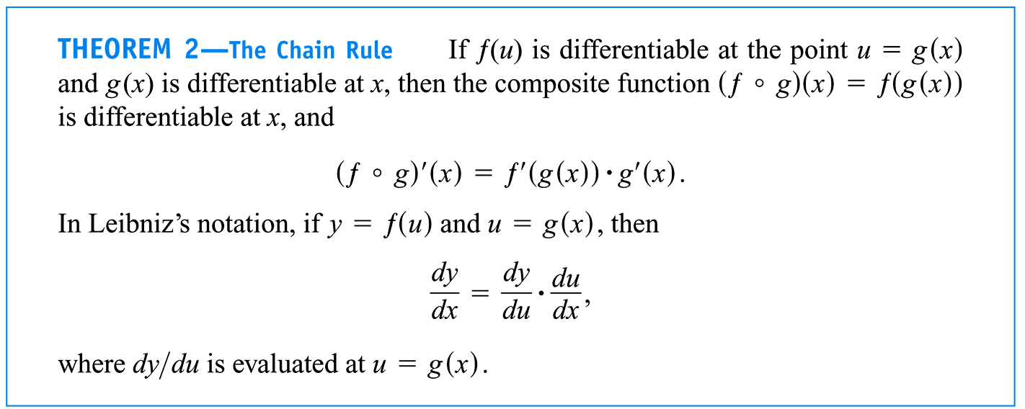

Slide 55
